Slide 1
PPOL 628: Text as Data – Computational Linguistics for Social Scientists
Class 7: Text Reuse

Slide 2
Today
Lecture: key points from readings.
Lab: text_reuse.R
Website: github.com/matthewjdenny/PPOL_628_Text_As_Data

Slide 3
Text Reuse vs. Similarity
Text Similarity: Overall, how similar are these documents?
E.g. They focus on the same topic, they use very similar words, they share the same viewpoint, same valence etc.
Often what we are interested in when we analyze documents to measure a latent concept.
Typically more efficient to calculate than text reuse because order does not matter.
Text Reuse: What character/words sequences are identical?
Only makes sense for larger chunks of text (e.g. sentences, paragraphs)
Does not necessarily imply same valence, viewpoint (e.g. pull quoting).
Does imply a direct connection between documents.

Slide 4
Text Similarity
Simplest formulation: do the rows for two documents in a document term matrix “look similar”?
Do they both use roughly the same terms, and in the same proportion/amount?
Embeddings approach (preview): If we were to embed the terms in this document in a k-dimensional space, would they generally be close?
Similarity Metrics in Practice: Standard approach is to define a distance function (usually Cosine or Euclidean distance), then apply to pairs of rows in DTM/contingency table.
Interpretation is strongly dependent on average document length.

Slide 5
Distance\Similarity Metrics
Input: pairs of vectors of term counts/proportions.
Can apply TF-IDF weighting to focus on differences in rare term use.
Shrinks stop-term counts.
Can be (relatively) efficient to calculate.
Apply to sparse term vectors.
Do not need to account for term position in documents.
Use cosine similarity if document length is not important.

Slide 6
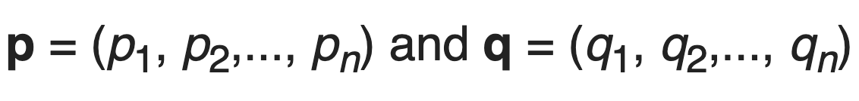
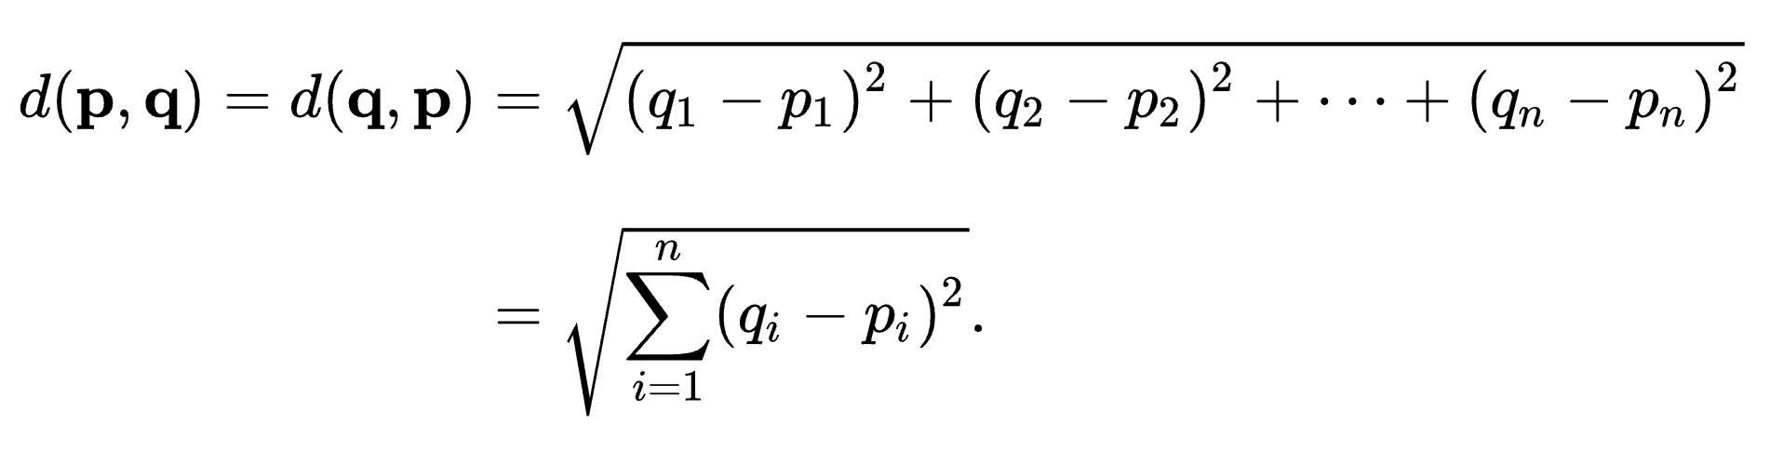
Euclidean Distance
Input: two term vectors:
Formula:
Increasing in differences between counts of individual elements.
Must be greater than or equal to zero, unbounded above.
Can be interpreted as a physical distance between cordinates.

Slide 7
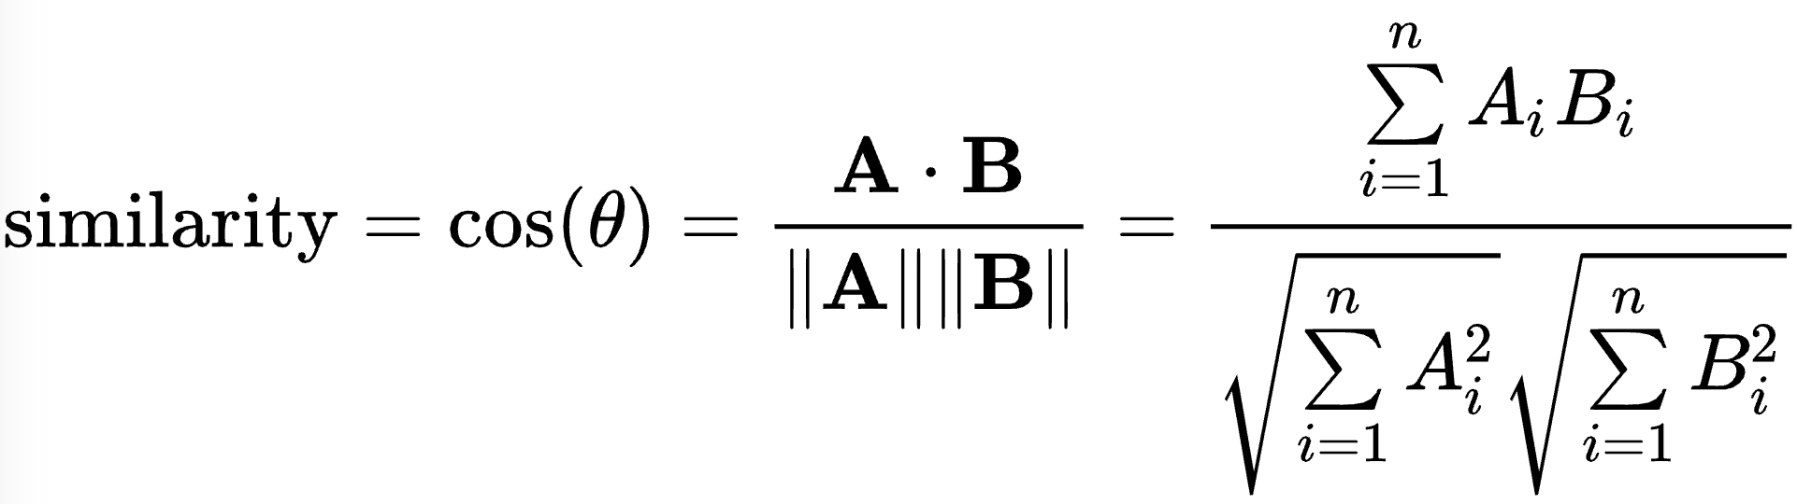
Cosine Similarity
Input: Let A and B be term vectors as with Euclidean Distance.
Formula:
For text, takes on a value between zero (totally unrelated) to one (meaning exactly terms appear in same proportion).
Interpreted as angle between term vectors.
Normalized for document length.

Slide 8
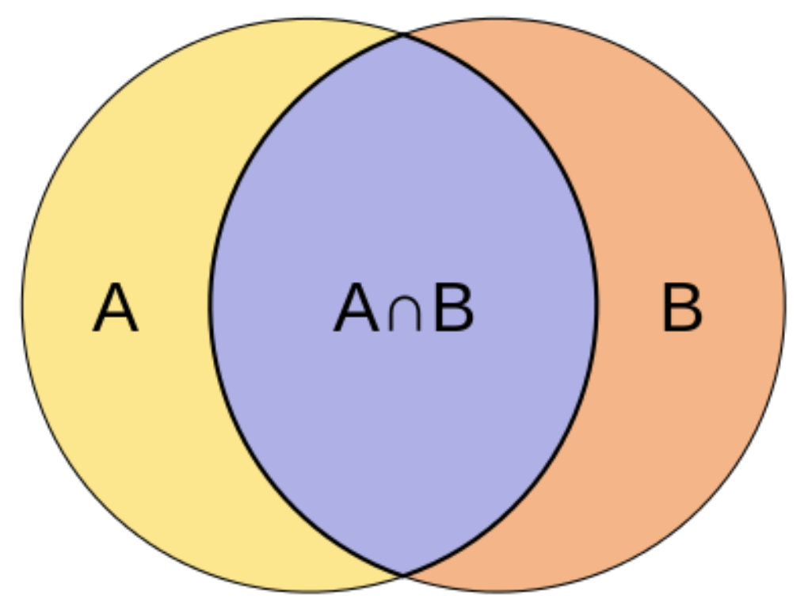
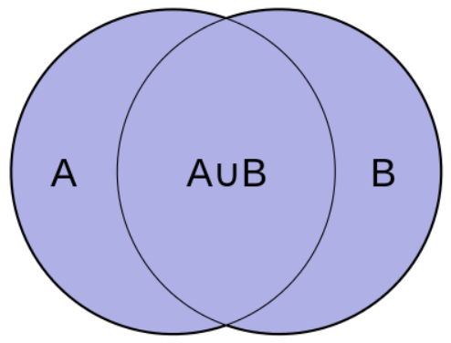
Jaccard Similarity
Input: Let A and B be term vectors.
Formula: S = number of unique terms in both A and B / number of unique terms in the union of A and B
For text, takes on a value between zero (totally unrelated) to one (meaning exactly the same unique terms appear).

Slide 9
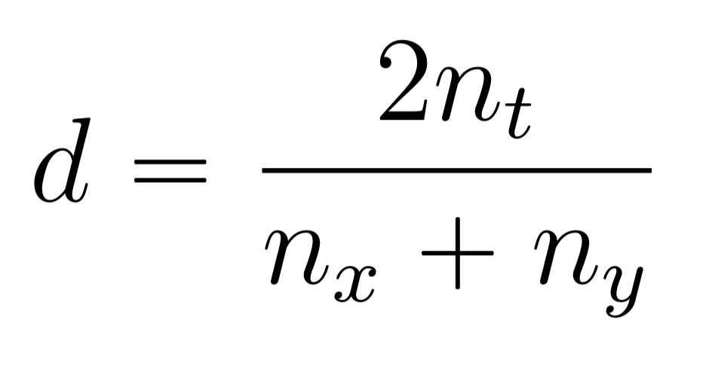
Sørensen–Dice coefficient
Start by taking documents and for each document, find all unique bigrams.
Let n_{t} be the number of unique bigrams that occur in both documents.
Let n_{x} and n_{y} be the count of unique bigrams in documents x and y respectively.
Formula:
Has a maximum value of 1 when all unique bigrams are the same, zero when none are the same.
Generalizes to n-grams of any length.
Potentially more informative because n-gram overlap indicates stronger similarity.

Slide 10
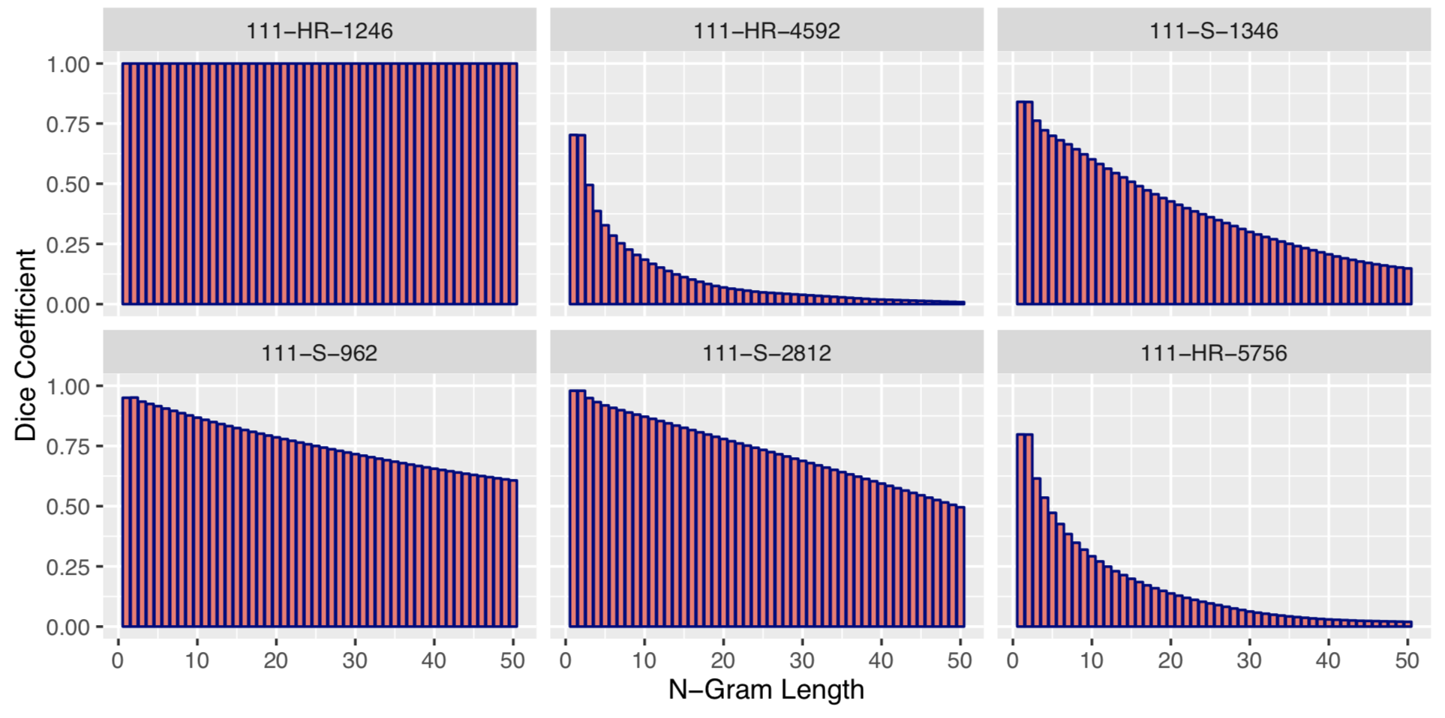
Sørensen–Dice coefficient Ensemble
Can vary n-gram length to understand similarities at different granularities.

Slide 11
Text Reuse
When we want to identify chunks of text that are the same between documents.
Plagiarism detection – want to actually pull out the overlapping parts.
Edit characterization – want to assess how document changed between versions.
Document subsumption – want to know if one document is now included in another document.
Document Similarity – Can serve as the basis for stronger similarity statements.
Citation/Quotation Importance – some passages that are included in many different documents. May also identify boilerplate passages.

Slide 12
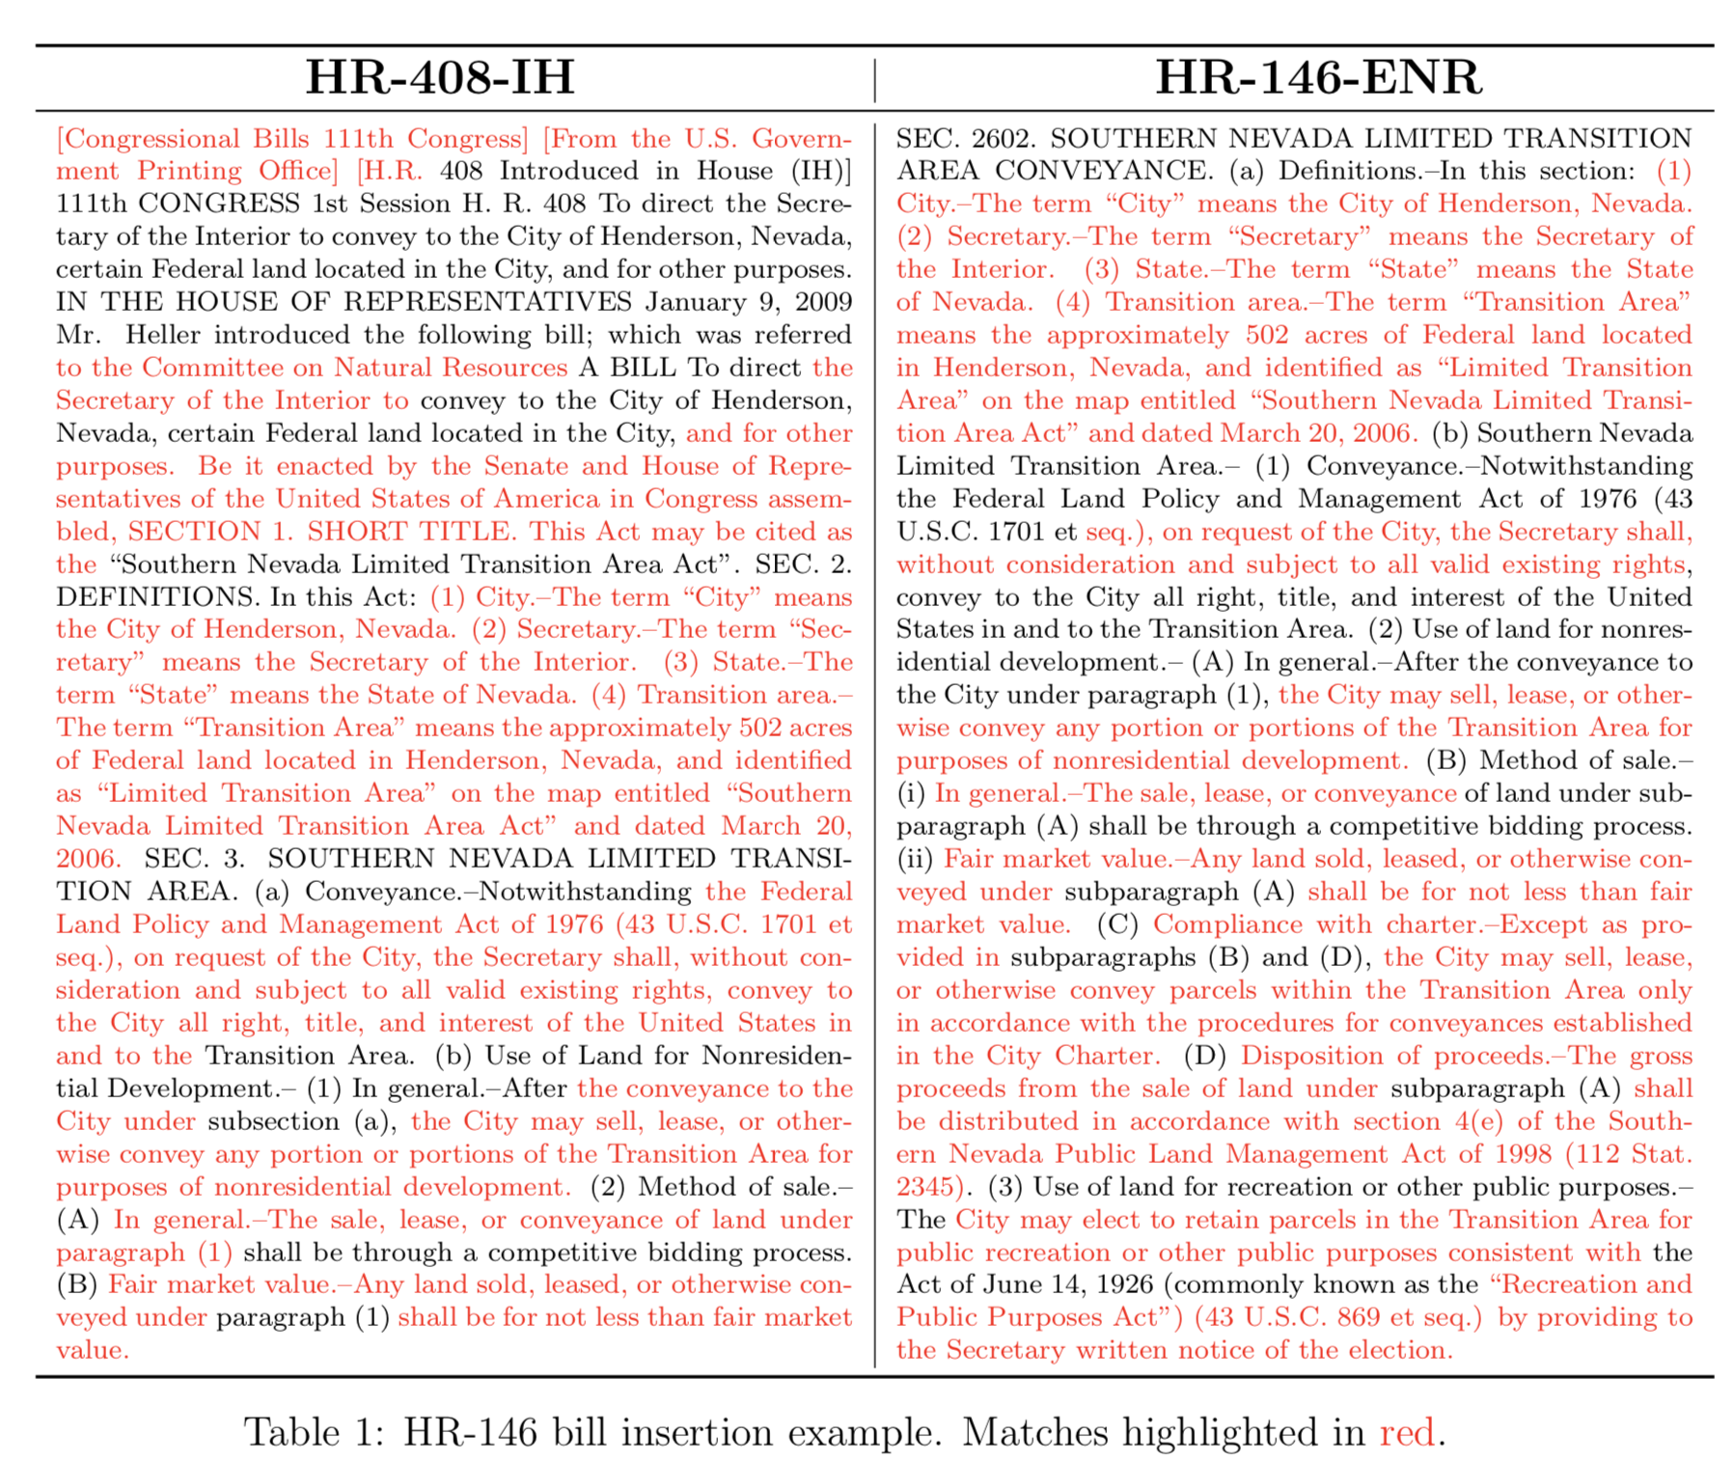
An Example:
A human reading these two passages could determine that the one on the right is effectively copied from the one on the left.

Slide 13
Text Reuse from a Technical Perspective
Primary challenge is computational.
With infinite time: compare all 1 to number-of-tokens-in-document—grams from each document with those from all others (order preserving). Find longest matches and induce graph structure.
Also difficult to pay a human to do since it requires exceptional memory.
In practice, we often want to filter on some similarity metric, topic scores, etc., then only check for exact matches if there is a reasonably high similarity.
Trade-off between speed and overlap detection quality.

Slide 14
Sequence Alignment Algorithms
Smith Waterman: Algorithm originally designed to align DNA sequences, handles gaps in match very well.
Very computationally intensive, provides high quality, easy to human understand results (with some fiddling).
More oriented towards providing an alignment between documents/DNA sequences. Characterization of match quality is up to end user.

Slide 15
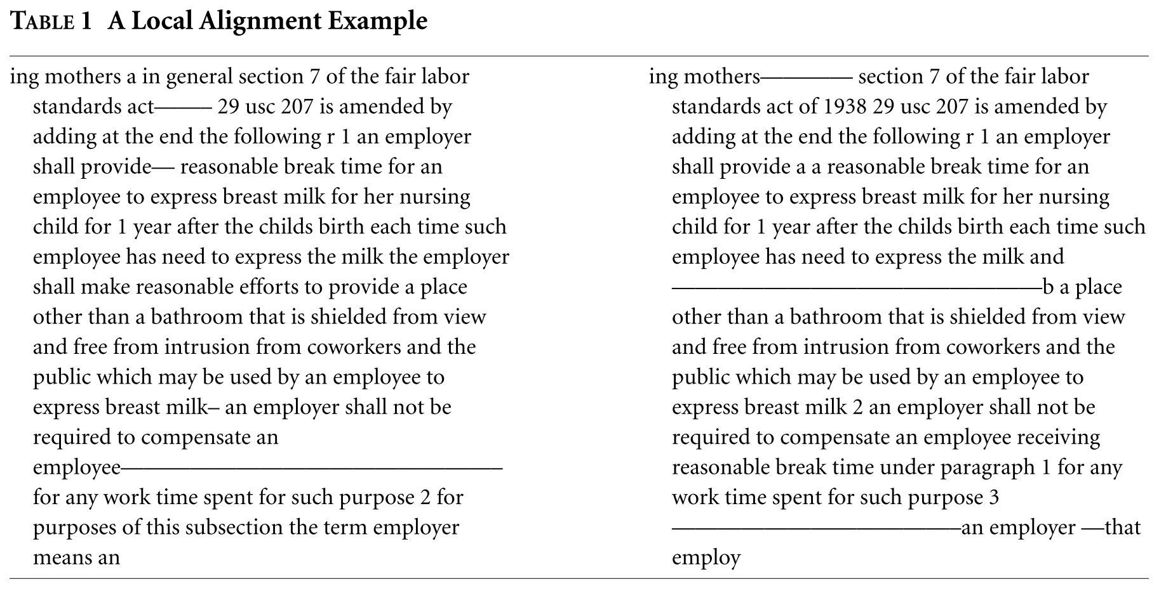
S-W Example (Wilkerson et al.,2015)

Slide 16
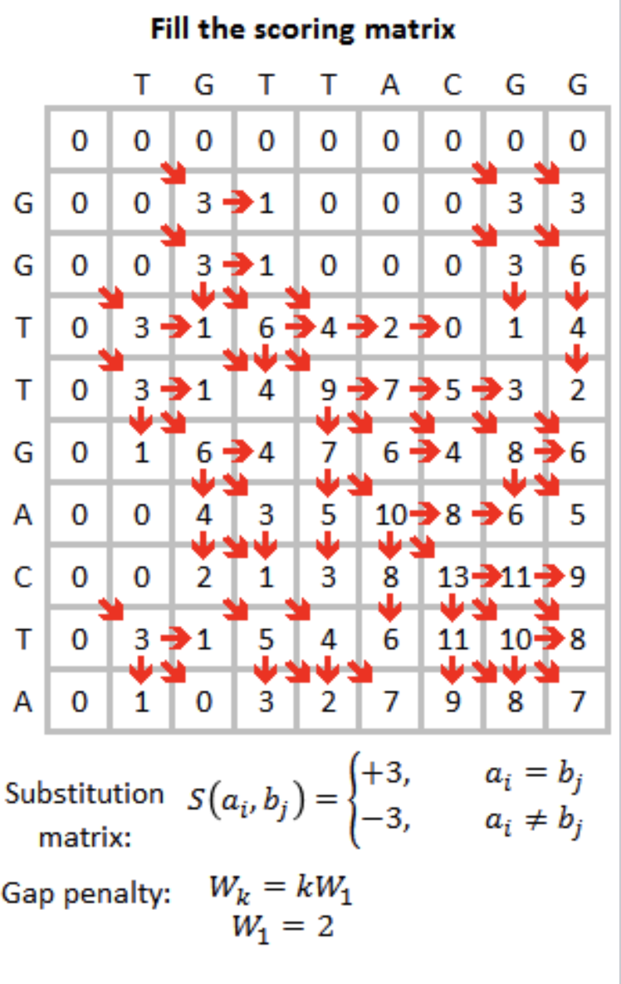
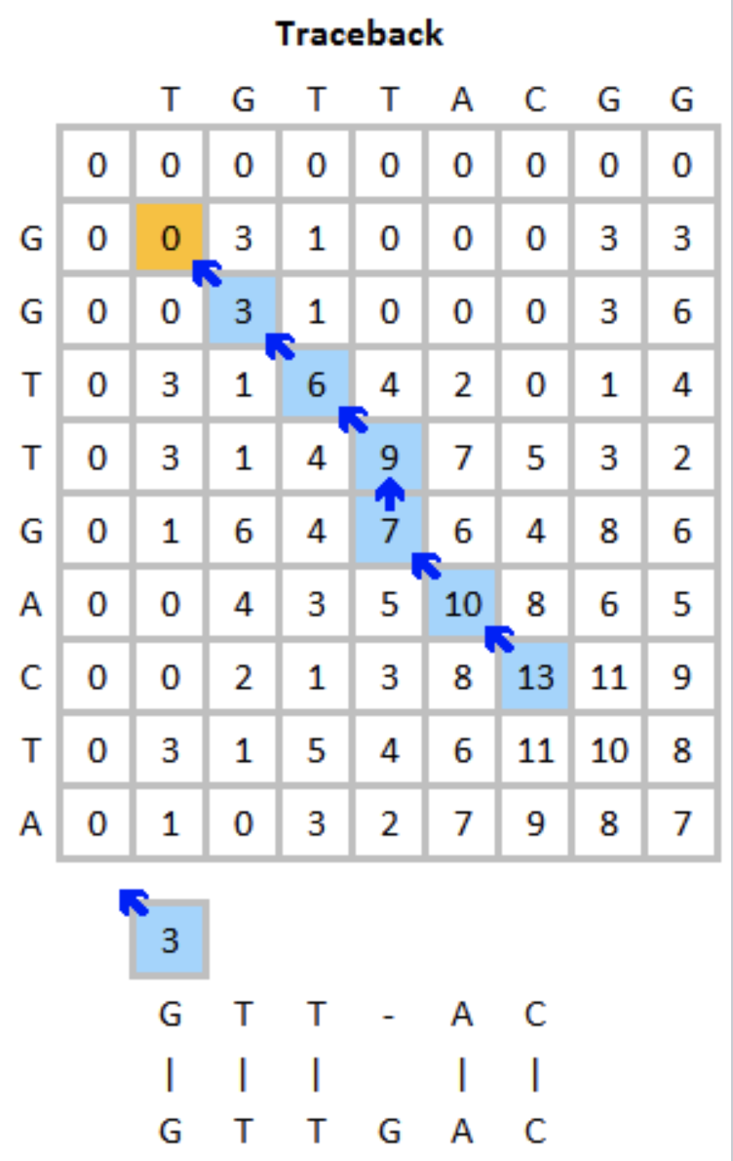
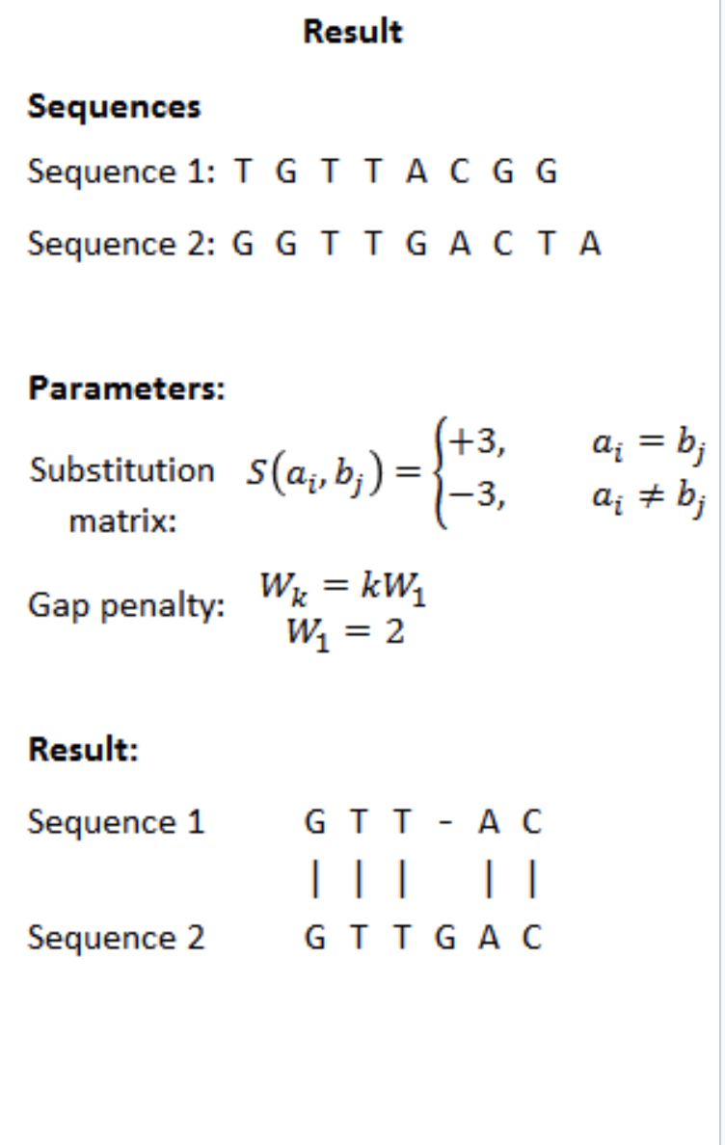
Smith-Waterman Algorithm

Slide 17
Shingled n-grams Similarity/Text Reuse Methods
Designed to identify matching sequences of terms/characters in text (like alignment algorithms), while having computational complexity on par with similarity metrics.
Shingled N-grams: n-grams that overlap with each one starting one token after the next.
3-gram example: “My fast brown cat runs” → [“my fast brown”, “fast brown cat”, “brown cat runs”]
Using longer n-grams reduces false positive match rate, decreases resolution (ability to identify valid shorter matches).

Slide 18
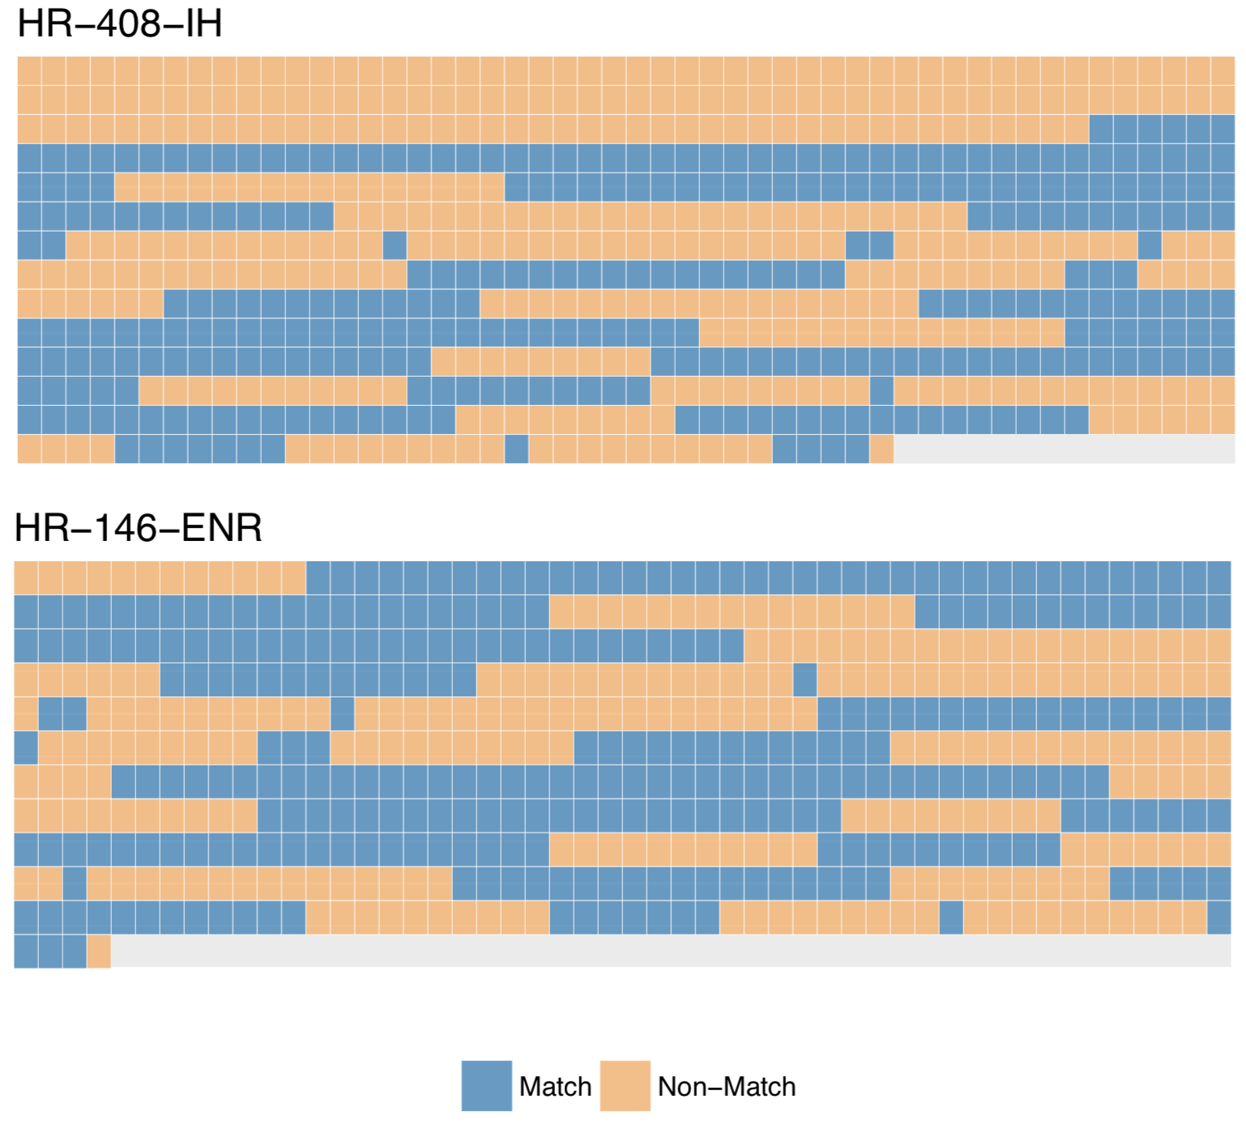
Basic Intuition
Each square represents an (overlapping) 10-gram in each document.
Blue squares are matches orange squares are mismatches.
Read from left to right then top to bottom.
Output as a vector of zeros and ones.

Slide 19
Shingled n-grams Implementation
Tokenize each document into shingled n-grams, preserve order!
For each shingle in each document to be compared, check to see if it appears anywhere in the other document, if so record a 1, else 0.
Note that for any one n-gram this could represent a false positive match, but with longer sequences of matched shingles, probability of true match increases.
End up with two vectors of zeros and ones (one for each document).
Can use these to highlight what parts of text have a match in other document.
Can calculate statistics one these match vectors like longest match sequence.

Slide 20
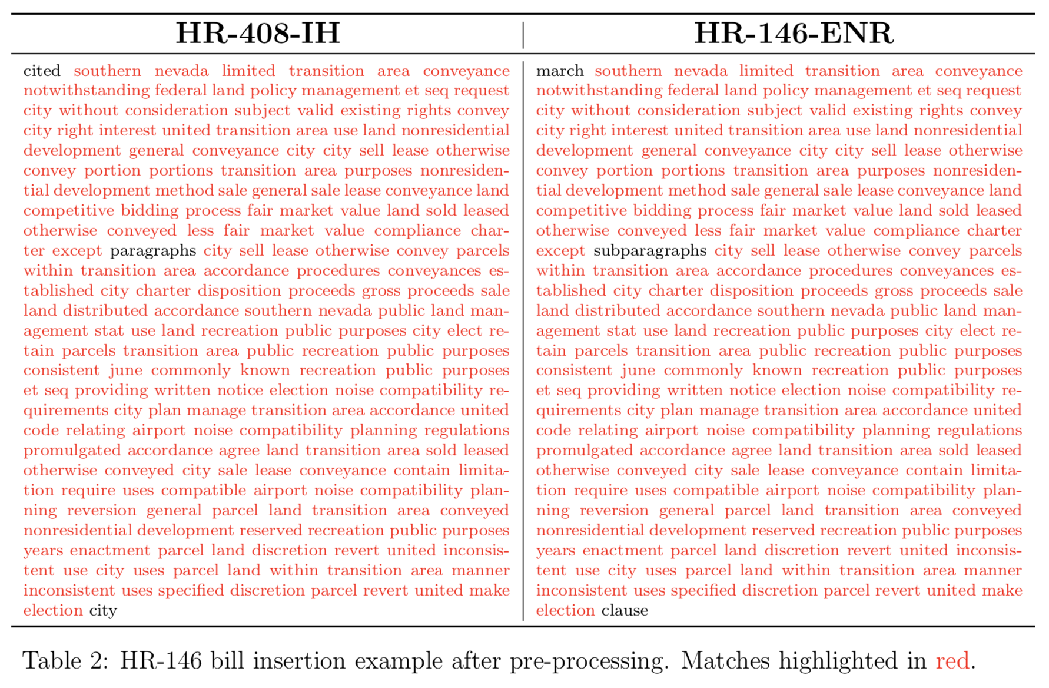
Effects of Preprocessing on n-gram matches

Slide 21
Deriving Information from Match Vectors
Output from shingled N-Grams matching:
Doc 1: {1,1,1,0,0,0,0,0,0,0,1,1,1,1,1,1,1,1,1,0,0,0,1,1,1,1,0,0,0,0,0,0,0}
Doc 2: {0,0,0,0,0,0,0,0,0,0,1,1,1,1,1,1,1,1,1,1,1,1,1,1,1,1}
Can now calculate arbitrary statistics on these vectors.
These data can be fed into a supervised learning model or used with some thresholds to identify plagiarism, document insertions into other documents, identical documents, etc.

Slide 22
Additions and Deletions
Scope of Deletions: the scope of deletions is just the proportion of shingled n-grams in the first version of the document that do not match an n-gram in the second version. This gives us a measure of how much of the original text survived to the second version of the text.
Scope of Additions: the scope of additions is similar to the scope of deletions, but is instead defined as the proportion of n-grams in the second version of the document that do not match an n-gram in the first version. This gives us a measure of how much of the edited version of the text was not present in the original version of the text.

Slide 23
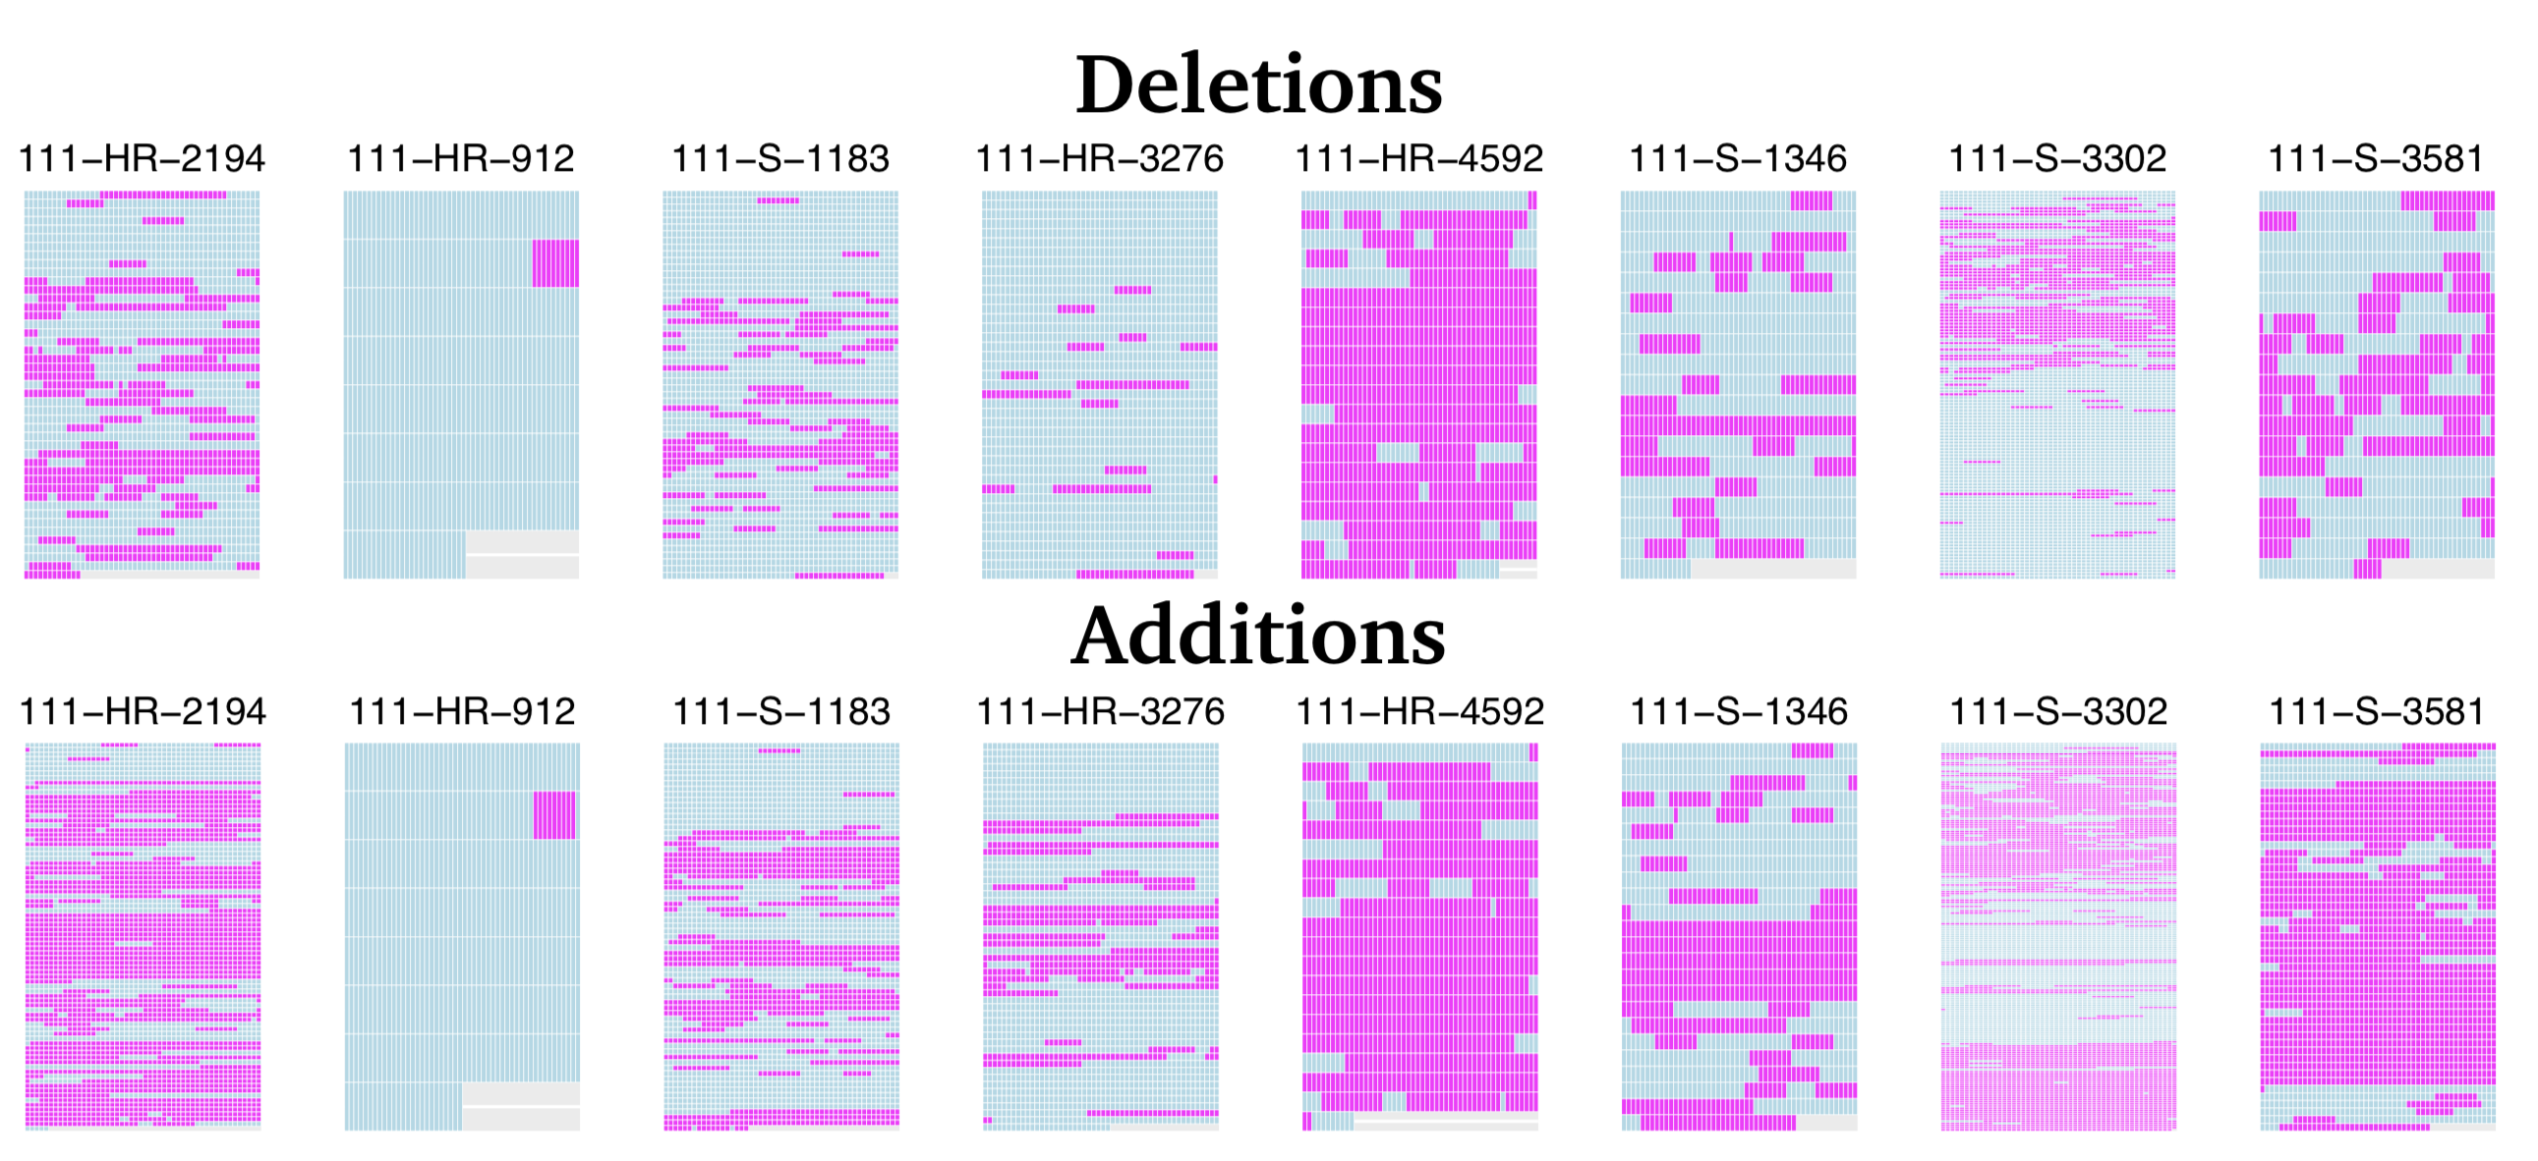
Additions and Deletions

Slide 24
Edit Size
Average Edit Size: the average edit size is defined as the average length of sequences of non-matching n-grams across both versions of a document. The shorter the average edits size, the shorter the length of edits made to a document. We do not normalize this measure by document length because this length has a natural interpretation.
Proportion of Possible Changes: this metric captures the number of unique sequences of mismatches in both versions of the text relative to the maximum number of sequences of mismatches possible given the n-gram length used for comparison. Thus is can range between zero, indicating that no changes were made at all, to one, indicating that a maximal number of unigram changes were made to the document (relative to the resolution limit implied by the choice of n-gram size).

Slide 25
Other Match Sequence Statistics
Edit granularity: related to the average edits size. Ranges between 0 and 1, and maximized when all edits are just a single term, and minimized when the document is just wholesale replaced by another document with unrelated text.
Match/Mismatch Sequence Variance, etc.: These statistics can tell us more about the variation in the sizes of matching bits of text and edits, which can be useful both as a substantive quantity of interest, and as input to downstream a classifier.

Slide 26
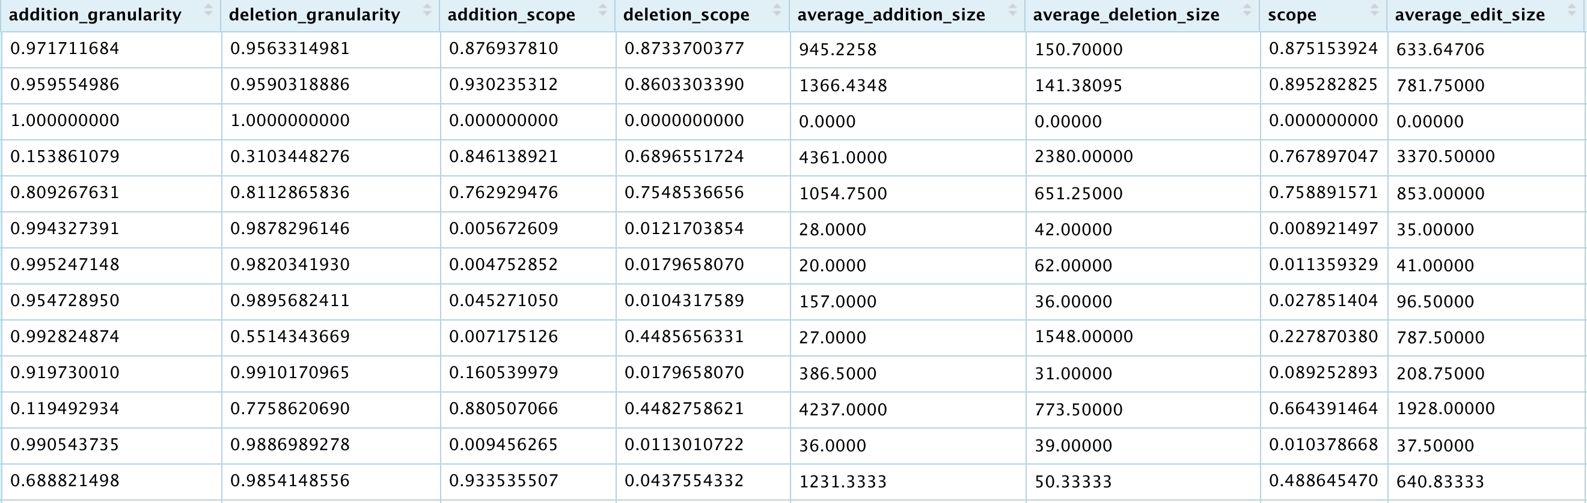
Algorithm Output as Input for Supervised Learning
Use these features to train a classifier to identify identical documents, plaigarism, etc.

Slide 27
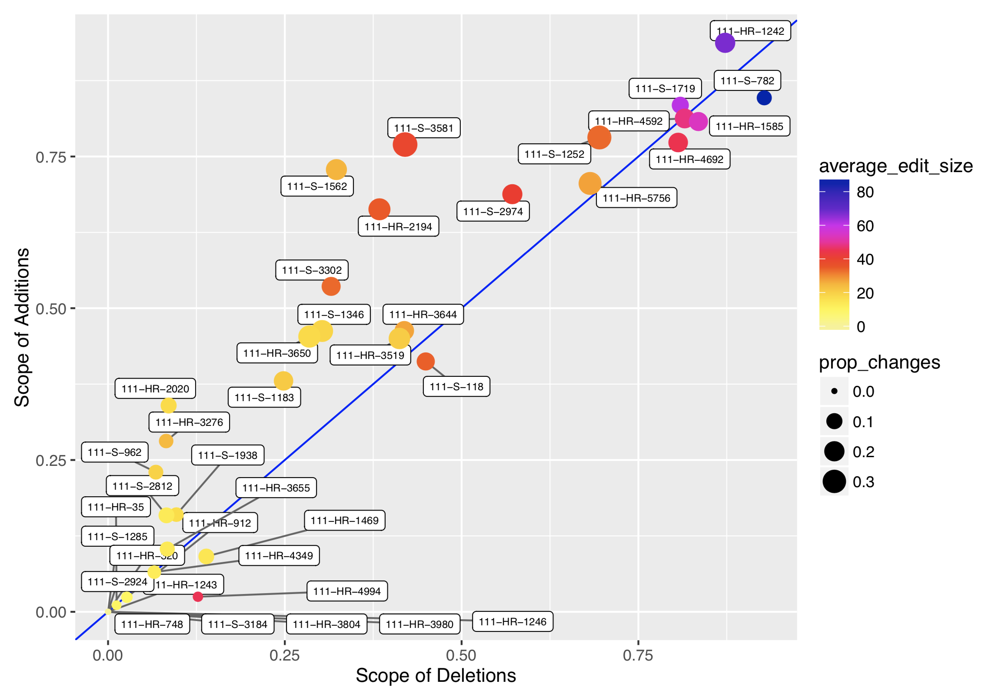
Characterizing Document Editing

Slide 28
General Points
Text similarity metrics can be useful for document clustering, and as a first step in assessing text reuse.
Some limitations as compared to other document clustering methods like topic models.
How useful text reuse methods end up being will greatly depend on how your corpus was generated.
Same authors, copying, etc. vs. incidental overlap.
Studying document editing is very new --> lots of theoretical and computational challenges.
There is no one globally optimal approach.

